Slide 1
AIPlaneTech FinTech Topic
(Index and Stock Futures, and Options in Indian Market)

Slide 2
Index and Stock Futures in India
Index Futures: These are futures contracts where the underlying asset is a stock market index, such as the Nifty 50 or the Sensex. They allow investors to speculate on the future value of the index. For example, if you believe the Nifty 50 will rise in the future, you can buy a Nifty 50 futures contract. If the index does rise, you can sell the contract at a higher price and make a profit.
Stock Futures: These are futures contracts where the underlying asset is an individual stock. For example, if you believe that Reliance Industries' stock price will increase, you can buy a futures contract on Reliance Industries. If the stock price does rise, you can sell the contract at a higher price and make a profit.
Let's say you believe that the Nifty 50 index will rise in the next three months. You decide to buy a Nifty 50 futures contract at a price of 20,000. If the index rises to 20,500, you can sell the futures contract at the higher price and make a profit of 500 points.

Slide 3
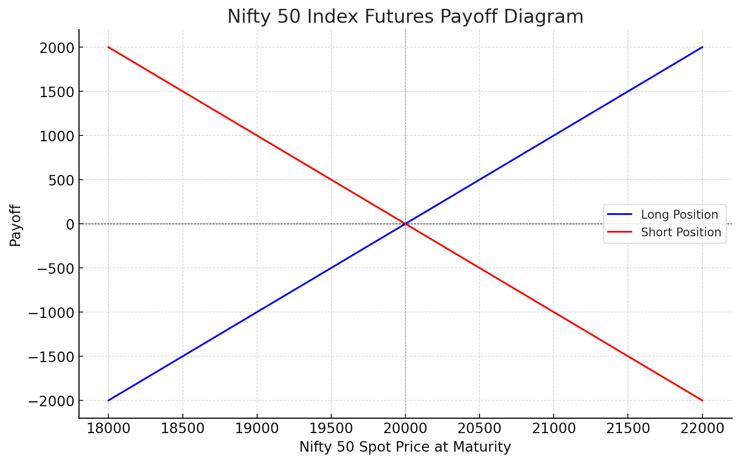
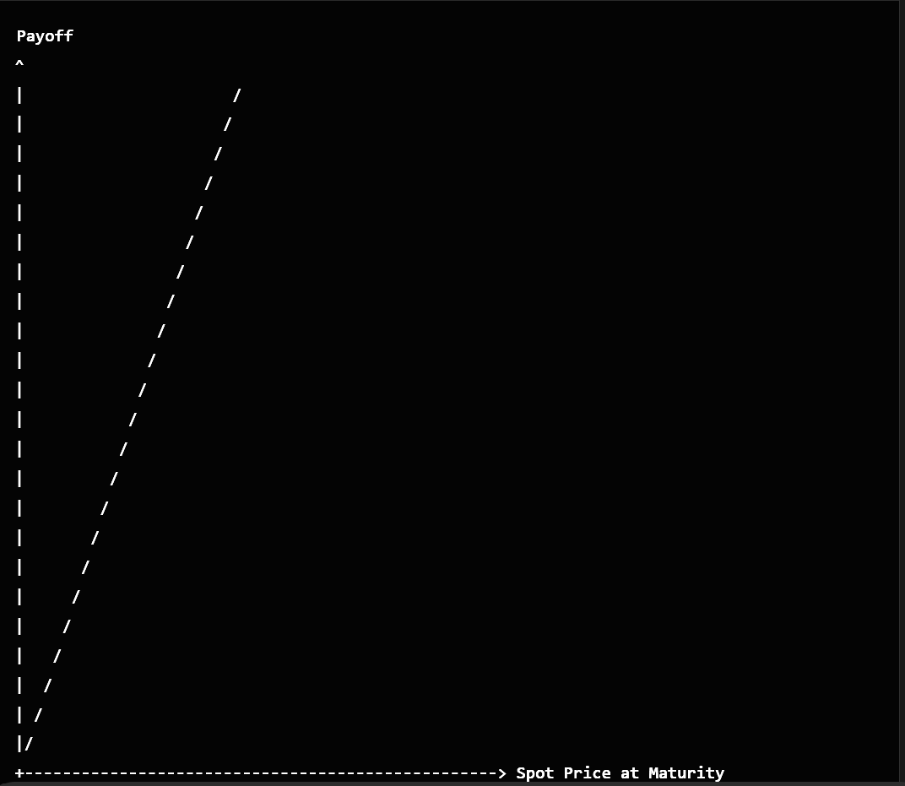
Index Futures - Payoff Diagram
Here is the Nifty 50 Index Futures Payoff Diagram (Upper)
The blue line represents the payoff for a long position in Nifty 50 futures. It shows a profit when the Nifty 50 spot price at maturity is above the contracted futures price (20,000) and a loss when it's below.
The red line represents the payoff for a short position, which profits when the spot price is below the contracted price and incurs a loss when it's above.
The intersection at 20,000 is the breakeven point for both positions.
As of February 19, 2025, the Nifty 50 futures contract expiring on February 27, 2025, is trading at approximately 22,942.75 INR.To visualize the potential payoffs for this futures contract, consider the following diagram (Lower)
The payoff line slopes upwards, indicating potential profit as the index level rises.

Slide 4
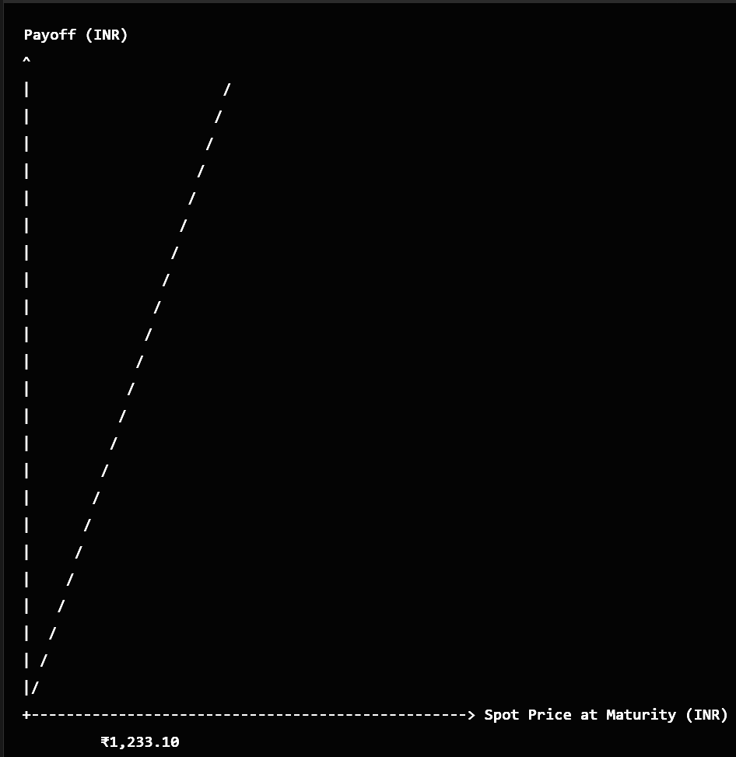
Stock Futures - Payoff Diagram
Payoff Diagram for Reliance Industries Futures
As of February 19, 2025, the Reliance Industries futures contract expiring on February 27, 2025, is trading at approximately ₹1,233.10 . To visualize the potential payoffs for this futures contract, consider the following diagram.
In this diagram:
Long Position: The upward-sloping line represents the payoff for a long position in the Reliance Industries futures contract. If the spot price at maturity exceeds the contracted futures price (₹1,233.10), the position yields a profit; if it's below, it results in a loss.
Short Position: Conversely, the downward-sloping line (not shown) would represent the payoff for a short position, profiting when the spot price is below the contracted price and incurring losses when above.

Slide 5
Index and Stock Options
Index Options: These are options contracts where the underlying asset is a stock market index. There are two types of options: call options and put options. A call option gives the holder the right, but not the obligation, to buy the index at a specified price (strike price) before a specified date (expiration date). A put option gives the holder the right, but not the obligation, to sell the index at the strike price before the expiration date.
Stock Options: These are options contracts where the underlying asset is an individual stock. Similar to index options, there are call options and put options. For example, if you believe that Tata Motors' stock price will rise, you can buy a call option on Tata Motors. If the stock price does rise above the strike price, you can exercise the option and buy the stock at the lower strike price, making a profit.
Alternatively, you could buy a call option on the Nifty 50 index with a strike price of 4,000 and an expiration date three months from now for 100. If the index rises to 4,500, you can exercise the option and buy the index at the lower strike price of 4,000, making a profit of 500 points minus the premium (100) paid for the option - net profit of 400.

Slide 6
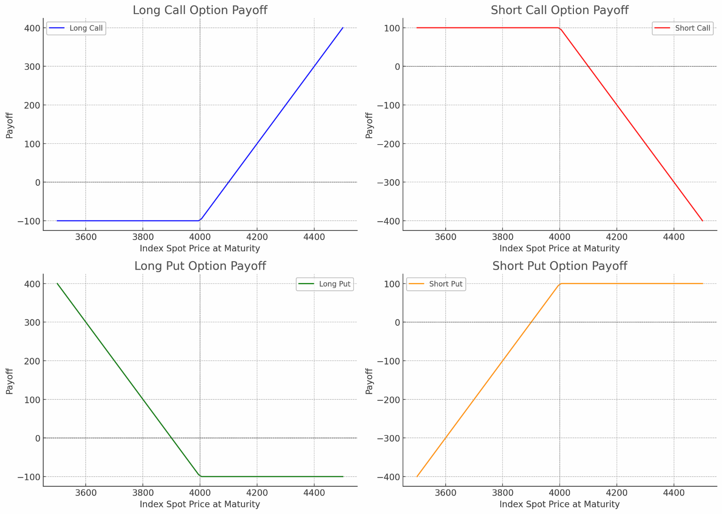
Index Option - Payoff Diagram
Here are the Index Option Payoff Diagrams:
Long Call Option (Top Left): The payoff increases as the index spot price rises above the strike price (4000), minus the premium paid (100). Loss is limited to the premium if the spot price is below the strike price.
Short Call Option (Top Right): The maximum gain is the premium received (100), but losses are unlimited as the spot price rises above the strike price.
Long Put Option (Bottom Left): The payoff increases as the index spot price falls below the strike price, minus the premium paid. The maximum loss is the premium if the spot price is above the strike price.
Short Put Option (Bottom Right): The maximum gain is the premium received, while the potential loss increases as the spot price falls below the strike price.

Slide 7
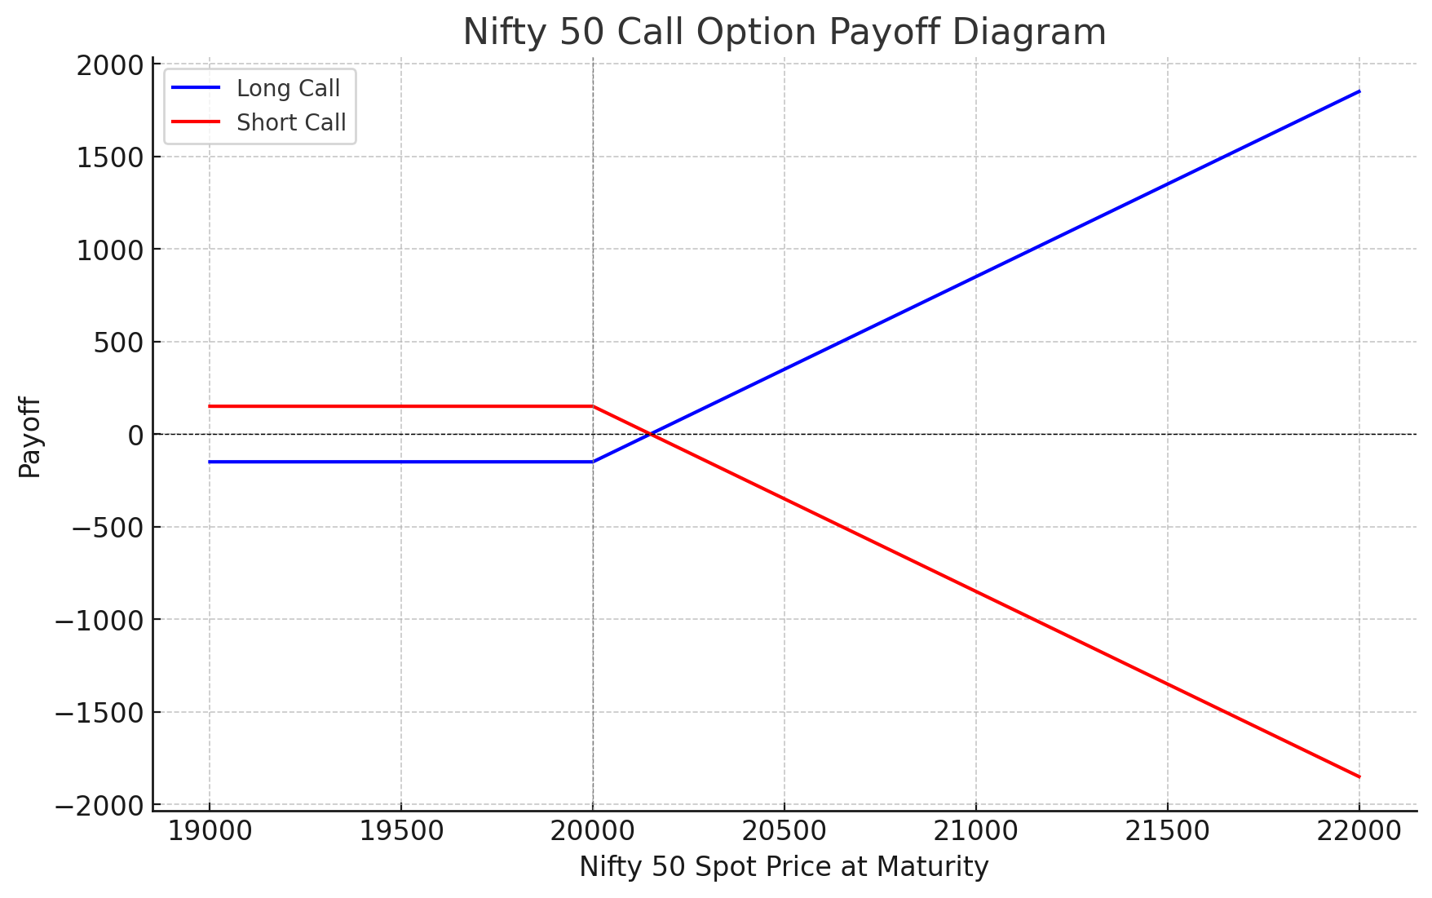
Index Option - Payoff Diagram
Payoff Diagram for Nifty 50 Call Option
A Nifty 50 call option provides the holder the right, but not the obligation, to purchase the Nifty 50 index at a predetermined strike price on or before the option's expiration date. The payoff for such an option depends on the position taken:
Long Call Position: If you anticipate that the Nifty 50 index will rise, you might purchase a call option. The payoff at expiration is calculated as the maximum of zero or the difference between the spot price at maturity and the strike price, minus the premium paid.
Short Call Position: If you expect the index to remain stable or decline, you might sell a call option. The payoff is the premium received minus the maximum of zero or the difference between the spot price at maturity and the strike price.
The payoff diagrams for both positions are linear beyond the strike price, reflecting potential profits or losses based on the index's movement.

Slide 8
Stock Option - Payoff Diagram
Tata Motors Stock Call Option
Brief Definition - Options contracts based on individual stocks
Types
Call Options: Right to buy stock at strike price
Put Options: Right to sell stock at strike price
Example
Tata Motors Call and Put Options
Payoff Diagram for Tata Motors Call Option
/
/
/
/
0-----|-------------------------->
Strike Price Stock Price
The payoff line slopes upwards after the strike price, indicating potential profit as the stock price rises.
Payoff Diagram for Tata Motors Put Option
\
\
\
\
\
0- - - - - - - -|----------------->
Strike Price Stock Price
The payoff line slopes downwards after the strike price, indicating potential profit as the stock price falls.

Slide 9
Differences: Options and Futures
The main difference between options and futures is that options give the holder the right to buy or sell an asset, while futures require the holder to do so. This makes futures riskier but potentially more rewarding.
Futures A futures contract is a binding agreement to buy or sell an asset at a set price on a specific date. The buyer and seller are locked into the trade.
Options An options contract gives the holder the right to buy or sell an asset at a set price on a specific date. The holder can choose to exercise the option or not.
Trading
Futures: Futures contracts are often used by farmers, airlines, and traders.
Options: Options are often used by investors to profit from or hedge against price changes.
Other considerations
Futures contracts require a margin deposit, while options require a premium payment.
Futures contracts are "marked to market" daily, while options are not.

Slide 10
Call Option - Detailed Example
Example: TCS Call Option
Underlying Stock: Tata Consultancy Services (TCS)
Option Type: Call Option
Strike Price: ₹3,500
Expiration Date: 30th March 2025
Premium: ₹100 per share
Lot Size: 300 shares

Slide 11
Example: Nifty 50 Index Call Option
Underlying Index: Nifty 50
Option Type: Call Option
Strike Price: ₹15,000
Expiration Date: 30th March 2025
Premium: ₹200 per share
Lot Size: 75 shares (one options contract)

Slide 12
Example Scenario: TCS Call Option
Underlying Stock: Tata Consultancy Services (TCS) Option Type: Call Option Strike Price: ₹3,500 Expiration Date: 30th March 2025 Premium: ₹100 per share Lot Size: 300 shares (one options contract)
Let's say you believe that TCS stock, currently trading at ₹3,400, will rise above ₹3,500 before the expiration date. You decide to buy one call option contract.
Total Premium Paid: Premium per share * Lot size = ₹100 * 300 = ₹30,000
Possible Scenarios:-
Stock Price Rises Above Strike Price
If the TCS stock price rises to ₹3,900 before the expiration date, you can exercise the call option.
You buy TCS shares at the strike price of ₹3,500 and sell them at the market price of ₹3,900.
Profit per share = ₹3,900 - ₹3,500 = ₹400
Total Profit = ₹400 * 300 shares = ₹120,000
Net Profit (after deducting the premium) = ₹120,000 - ₹30,000 = ₹90,000
Stock Price Remains Below Strike Price
If the TCS stock price remains below ₹3,500, you may choose not to exercise the option.
In this case, you lose the premium paid.
Loss = ₹30,000
Stock Price Is Exactly at Strike Price:
If the TCS stock price is exactly ₹3,500 at expiration, exercising the option won't result in any profit or loss from the option contract.
Loss = Premium paid = ₹30,000
Summary: Buying a call option can give you significant leverage with limited risk (the premium paid). If the stock price rises above the strike price, you can potentially make a profit. However, if the stock price remains below the strike price, the maximum loss is limited to the premium paid for the option.

Slide 13
Black-Scholes Model for Option Pricing
The Black-Scholes Model is a mathematical model used to calculate the theoretical price of options.
Call Option Price: C=S₀N(d₁)−Xe−rTN(d₂)
Put Option Price: P=Xe−rTN(−d₂)−S₀N(−d₁)
Where: S₀
d₁=ln⁡(S₀/X)+(r+σ2/2)TσT
d₂=d₁−σT
S₀ = Current stock/index price
X = Strike price
r = Risk-free interest rate
T = Time to maturity
σ = Volatility of the stock/index
N(⋅) = Cumulative distribution function of the standard normal distribution

Slide 14
Black-Scholes Model Example - Call Option Calculations
Example: Nifty 50 Call Option
Current Index Price (S₀): ₹15,000
Strike Price (X): ₹15,000
Risk-Free Interest Rate (r): 5%
Time to Maturity (T): 6 months (0.5 years)
Volatility (σ): 20%
Calculations:-
Calculate d₁:
d₁=ln⁡(15,000/15,000)+(0.05+0.22/2)×0.50.20.5=0.2475
Calculate d₂:
d₂=d₁−σT=0.2475−0.1414=0.1061
Calculate Call Option Price:
Call Option Price: C=S₀N(d₁)−Xe−rTN(d₂)
C=15,000×N(0.2475)−15,000×e−0.025×N(0.1061)=15,000×0.5987−15,000×0.9753×0.5426≈1,039.4

Slide 15
Black-Scholes Model Example - Put Option Calculations
Example: Nifty 50 Put Option
Current Index Price (S₀): ₹15,000
Strike Price (X): ₹15,000
Risk-Free Interest Rate (r): 5%
Time to Maturity (T): 6 months (0.5 years)
Volatility (σ): 20%
Calculations:-
Calculate d₁ (same as call option): d₁=0.2475
Calculate d₂ (same as call option): d₂=0.1061
Calculate Put Option Price:
Put Option Price: P=Xe−rTN(−d₂)−S₀N(−d₁)
P=15,000×0.9753×N(−0.1061)−15,000×N(−0.2475)=15,000×0.9753×0.4574−15,000×0.4013≈ ₹673.3

Slide 16
Advantages of Futures and Options
Leverage
Small initial investment, potential for large gains
Hedging
Protects against adverse price movements
Flexibility
Multiple strategies and expiration dates

Slide 17
Risks of Futures and Options
Leverage
Potential for large losses
Market Volatility
Price fluctuations can affect investments
Complexity
Requires understanding and expertise

Slide 18
Conclusion
Summary
Importance of understanding futures and options
Potential for profit and hedging
Awareness of risks involved

